Slide 1

Talking to a MACHINE
Through Convolutional Neural Networks and Recurrent Neural Networks(LSTM).

Slide 2
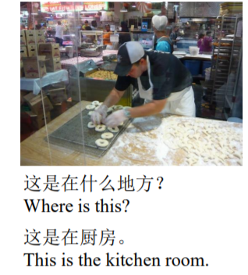
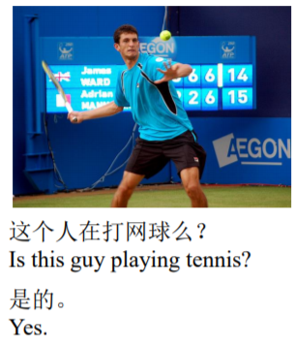
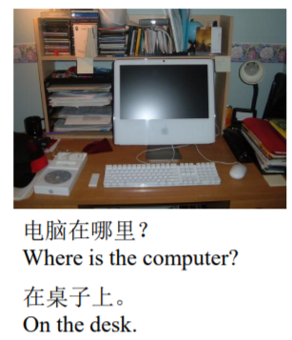
Inputs and Output
➔ We give the trained model an image and a question related to the content of the image
The model predicts the answer for the question and outputs in words
Ex:

Slide 3
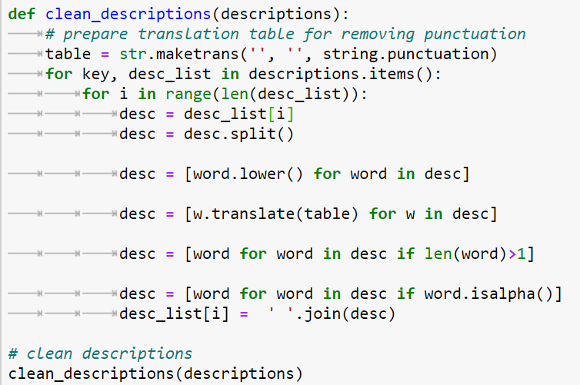
Data Cleaning
➔Convert all words to lowercase.
➔Remove all punctuation.
➔Remove all words that are one character or less in length (e.g. ‘a’).
➔Remove all words with numbers in them.
Cleaning the text in the above ways reduces the size of the vocabulary , which in turn make our smaller
Model to train faster.

Slide 4
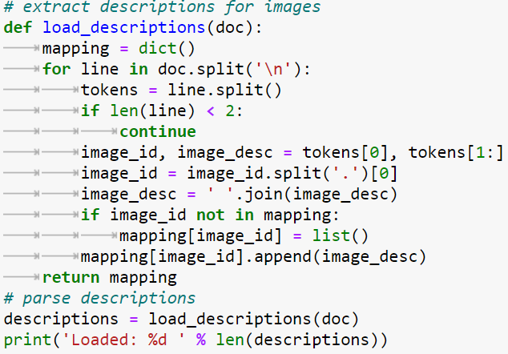
Dataset and Preprocessing
“Image_id + question about the image + answer “
Is a tuple in our Dataset for training and Validation
➔Our Dataset consists around 30k tuples of above notation separated by spaces.
➔We create a map ,with key as image_id and question+’ ‘+ answer as value
It is stored in map named “descrpitions”
→every answer is modified as
V
<start_seq> answer <end_seq>

Slide 5
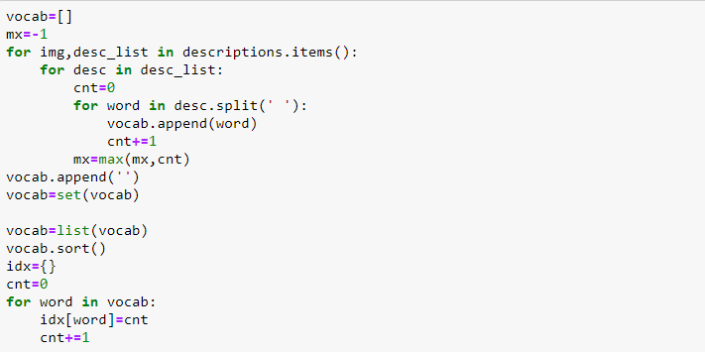
How we deal with different words to be
understood by the model differently?
➔We insert all the words in the questions and answers into a Set to find out list of unique words.
Then each word mapped with it’s index in a map named “Vocabulary”.
➔Hence each word’s unique number can be found at any time using that map(“Vocabulary”)

Slide 6
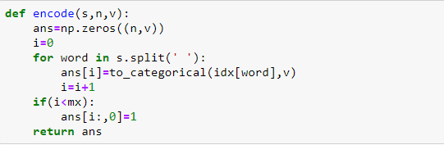
Transforming Questions and Answers into vectors
➔Every word in the question has unique number assigned to it, hence each
question is a sequence of numbers
Like : 34 1 434 78 1212 . . . . . . 223
➔We will find the maximum size of question from descriptions ,let it be max_size
➔Using embedding layer from keras we convert each number into a 256 sized vector and padding is used to make the length of every question equal to max_size
➔For simple understanding we can also use one-hot encoding for every number
but this makes every vector to be of size of Vocabulary, which makes computation more.

Slide 7
Extracting Features from an image
=➔VGG16 is a image recognition model, developed by Oxford
➔we remove the last classification layer from this Convolutional Neural Network Model and obtain the feature vector of every image individually and stored.
Image array
VGG16()
model
Feature vector
[4096]

Slide 8
Training Datapoints
Let an answer be of five words and the sequence of words be <start>, 34,45,3,2,67, <end>
for an image i and question q .
➔Then we divide the part of answer + question +image into following :
INPUTS OUTPUT
i + q + [<start>] 34
i + q + [<start>+ 34 ] 45
i + q + [<start>+ 34 + 45] 3
i + q + [<start>+ 34 + 45 + 3] 2
i + q + [<start>+ 34 + 45 + 3 + 2] 67
i + q + [<start>+ 34 + 45 + 3 + 2+ 67] <end>
➔Now these input-ouput pairs as an individual datapoints ,we train the model.

Slide 9
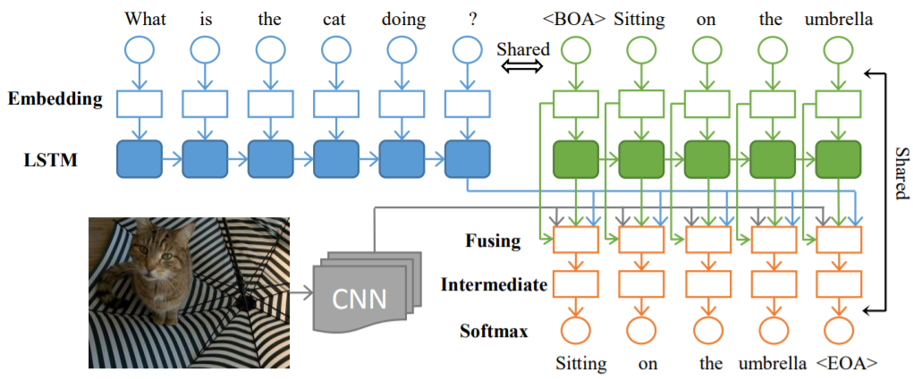
Model Overview

Slide 10
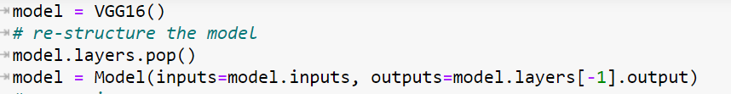
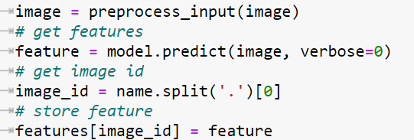
Model
➔similar to the question , the part of answer is also passed through LSTM and a feature vector is obtained.
➔Image is passed through trained image recognition model ,with it’s last layer removed to obtain the feature vector.

Slide 11
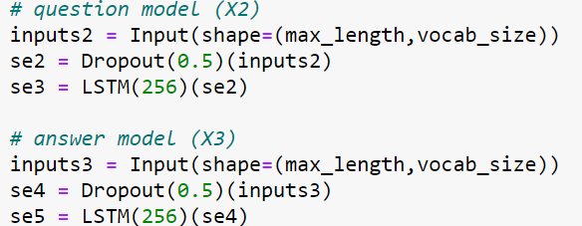
➔To understand the semantic meaning of the question we pass it through LSTM layer to get a feature
Vector.
➔To understand the semantic meaning of the question we pass it through LSTM layer to get a feature
Vector.

Slide 12
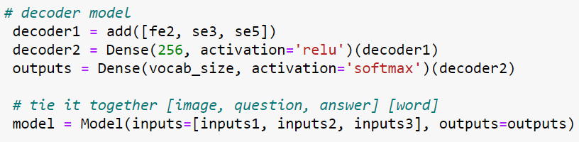
➔These three layers are tied together and dense network layer is added ,then trained by
by one hot vector of output word at output layer.

Slide 13

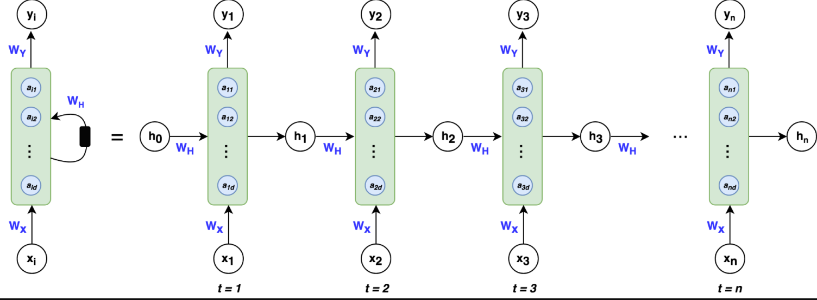
Why should we use Recurrent Neural Networks (LSTM) for understanding sentences better?
Normal dense neural networks can’t understand the meaning
because ,most times meaning of a word depends on words
Adjacent to it
This limitation can be easily overcame by Recurrent Neural Networks.
Here at every iteration each word(vector corresponding to it) is sent and final vector is obtained after all the word are sent ,which gives the dependency of previous words on the current words.

Slide 14
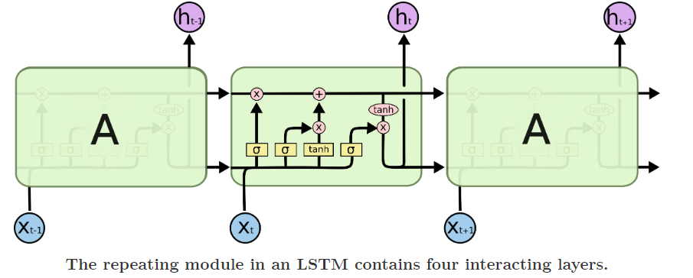
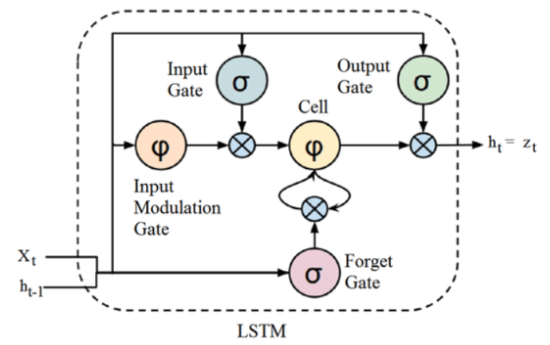
Why LSTM(Long Short Term Memory) ?
Introducing more & more controlling knobs, which control the flow and mixing of Inputs as per trained Weights. And thus, bringing in more flexibility in controlling the outputs. So, LSTM gives us the most Control-ability and thus, Better Results.
➔LSTMs can remember more information about previous iterations , hence gives better results
The remember vector is usually called the forget gate . If output of forget gate is 0 , then previous information is forgot else if 1,saves.
The save vector is usually called the input gate. These gates
determine which information should enter the cell state / long-term memory.

Slide 15
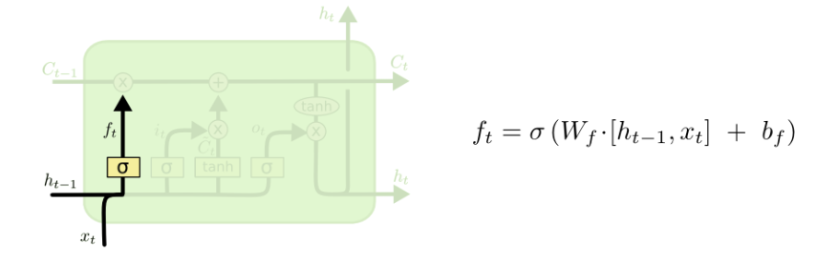
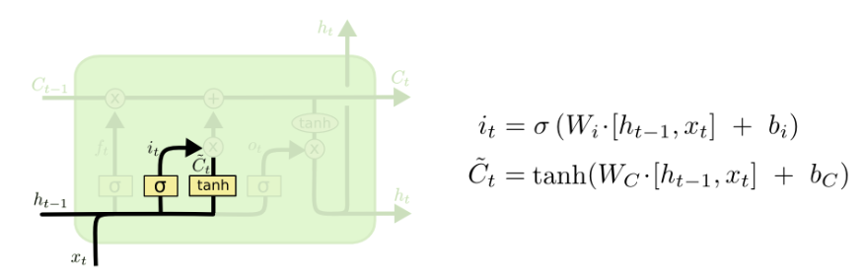
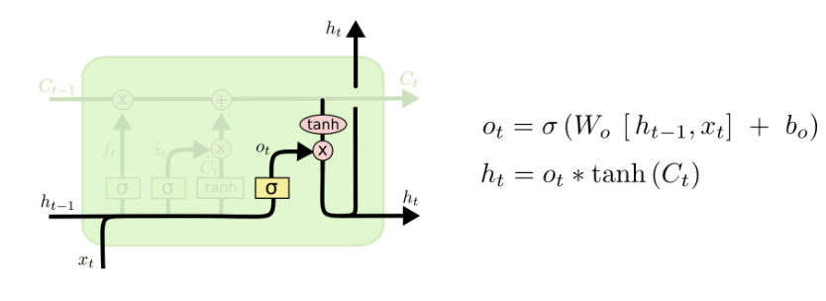
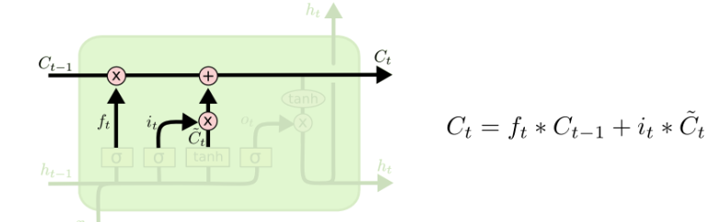
Gates in a LSTM unit
Forget gate
Update gate
Calculating chain
Output gate

Slide 16
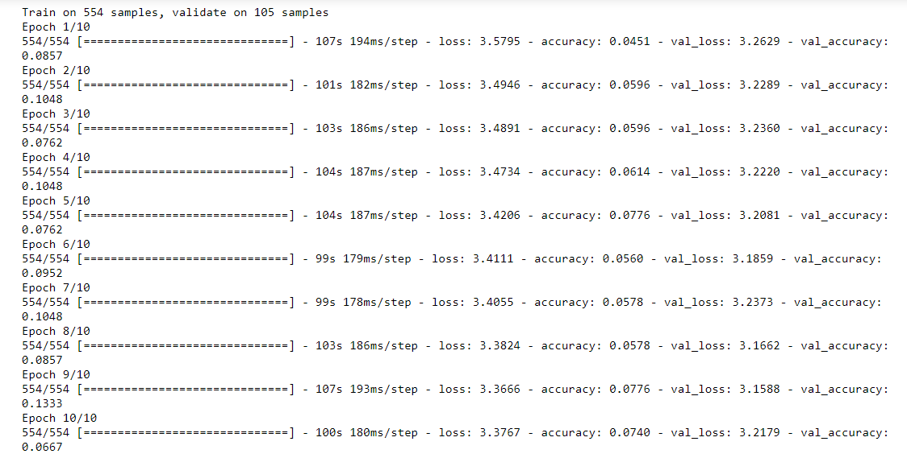
Training Result
Training is done for 10 images for 10 epochs.
Time taken for 10 images is 17 min, then for 8000 images time taken will be 136933 min = 95 days

Slide 17
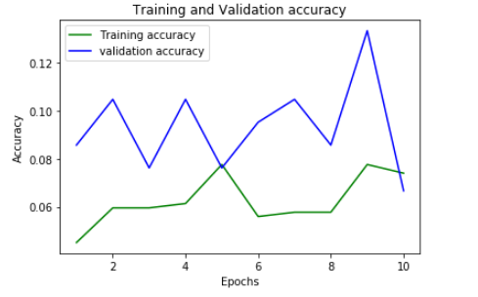
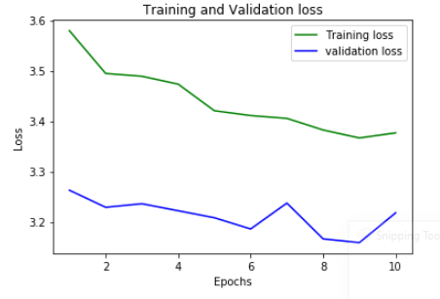
Accuracy
Loss
Validation accuracy > Training accuracy
Validation loss < Training loss
It is a good sign that even after using just 10 images our model performs better for validation data

Slide 18
Evaluation
➔Test set contains tuples of image_id(i) and question in words(q).
➔For each tuple of q + i , we obtain their respective feature vectors and <start> token will be added to answer part.
➔Then pass them through the trained model, and at output we obtain next word.
➔we append this word to answer part and passed again into model to obtain next word ,until the output is vector corresponding to <end> token.
q + i + [<start>]
Model
14
q + i + [<start>+14]
456
……..
4576
q + i + [<start>+14+…..]
<end>

Slide 19
Predicting Function
def generate_caption(model,feature):
X1=np.zeros((1,4096))
X2=np.zeros((1,mx,len(vocab)))
X3=np.zeros((1,mx,len(vocab)))
X1[0]=feature
X2[0]=encode(questions[0],mx,len(vocab))
X3[0]=encode("startseq",mx,len(vocab))
ans="startseq"
while(1):
Y=model.predict([X1,X2,X3])
Y=np.argmax(Y)
ans=ans+' '+vocab[Y]
print(vocab[Y])
if(vocab[Y]=='endseq'):
break
X3[0]=encode(ans,mx,len(vocab))
return ans

Slide 20

By
Soumyadip Sarkar
Bharath Vuppula
K Praveen Verma
Rohit Rachalwaar

